Slide 1
CHAPTER 6
DATA COMMUNICATIONS

Slide 2
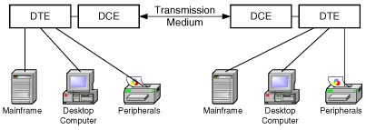
Components of a Basic
Data Communications Link

Slide 3
Data Networks Terminology
Data Network
  Collaborative environment that provides worldwide access to corporate data
Network Architecture
  A coordinated set of guidelines that describe a communications environment
DTE (Data Terminal Equipment)
  Transmits and receives data; Examples: Desktop computer, Printer
DCE (Data Communications Equipment)
  Coupled to transmission medium; Examples: Router, Modem
Interface
  Provides handshaking from one layer to the next; Example: NIC
Protocol Converter
  Connects two systems at the same layer; Example: Bridge

Slide 4
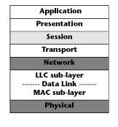
Open Systems Interconnect (OSI)
Reference Model
ISO recommends the Open Systems Interconnect (OSI) Model as a theoretical framework for communication between two machines in a LAN. It defines the parameters for communication hardware and software

Slide 5
Physical Layer
Interfaces network devices with transmission medium and provides the hardware a means of sending and receiving data
Responsible for data coding (converting 0s and 1s into electrical or light pulses)
Defines physical and electrical specifications for transmission

Slide 6
Data Link Layer
Data Link layer is divided into two parts:
  Media Access Control (MAC) lower sub-layer
  Logical Link Control (LLC) upper sub-layer
MAC sub-layer
  Specifies the access methods used, example IEEE 802
LLC sub-layer
  Brings various topologies together in a common format
  Provides error-control and synchronization, common to all access methods, at the node-to-node basis

Slide 7
Network Layer
Defines network segmentation and network address scheme (IP/IPX)
Handles routing and forwarding of the data
  Virtual Circuit
    Connection from sender to receiver is established on demand, and then functions as a point-to-point connection
  Datagram
    Packets are delivered individually, so they can take different routes and arrive at the destination at different times
    Packets are reassembled at the destination

Slide 8
Transport Layer
Manages end-to-end control
Assures end-to-end reliability and error-free data transfer
Translates and manages message communication through sub-network
Ensures data integrity and deals with packet sequencing
Selects most cost-efficient communications service based on transmission parameters

Slide 9
Session Layer
Responsible for connection negotiation
Authenticates and allows network access to users
Establishes and maintains connection between applications at each end
Synchronizes dialog between applications
Handles crash recovery

Slide 10
Presentation Layer
Handles network security and architecture-independent data formats
Provides data conversion, compression, and encryption
Translates data format of sender to data format of receiver
Commonly known as the syntax layer

Slide 11
Application Layer
Provides an interface to the end-user
Manages program requests that require access to services provided by a remote system
Identifies quality of service (QoS), user authentication, and other constraints on the data syntax

Slide 12
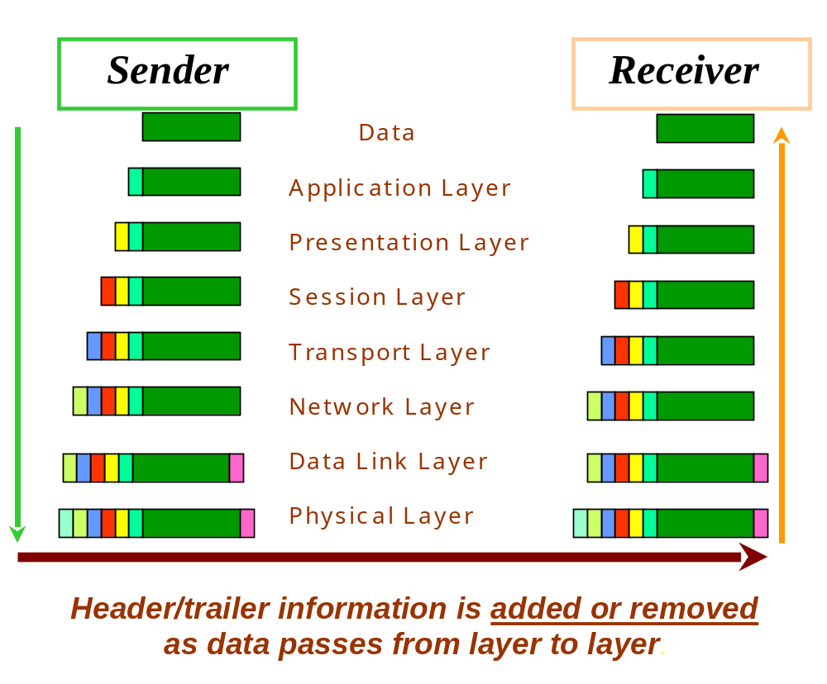

Slide 13
Character Codes
A byte is a string of 8 bits, which normally represents a character
A character is a specific symbol or a string of 0s and 1s
A character code refers to a way of converting alphabets, numbers, punctuation marks, and other special characters into a series of 0s and1s
There are several different character codes such as Baudot, EBCDIC (Extended Binary Coded Decimal Interchange Code), and ASCII (American Standard Code for Information Interchange)

Slide 14
ASCII Character Code
ASCII
  ASCII was established to achieve compatibility between various types of data processing equipment
  A standard seven-bit code that was proposed by ANSI in 1963, and finalized in 1968
  With seven bits it is possible to differentiate 2⁷ or 128 different patterns. The standard ASCII character set consists of 128 decimal numbers ranging from zero through 127 assigned to letters, numbers, punctuation marks, and the most common special characters

Slide 15
Data Encoding Methods
Data Encoding deals with how best to transmit data (0s and 1s) across various media
Popular Data Encoding Methods
  NRZ (Non-Return to Zero)
  Bipolar AMI ( Bipolar Alternate Mark Inversions)
  B8ZS ( Bipolar with 8 Zero Substitution)
  Manchester Encoding
  Multi-Level Transition (MLT-3)
  4B/5B Encoding
  2B1Q ( 2 Binary 1 Quaternary)

Slide 16
Shannon’s Channel Coding Theorem
Shannon’s Channel Coding Theorem states that if the transmission rate is equal to or less than the channel capacity, then there exists a coding technique which enables transmission over the channel with an arbitrarily small frequency of errors

Slide 17
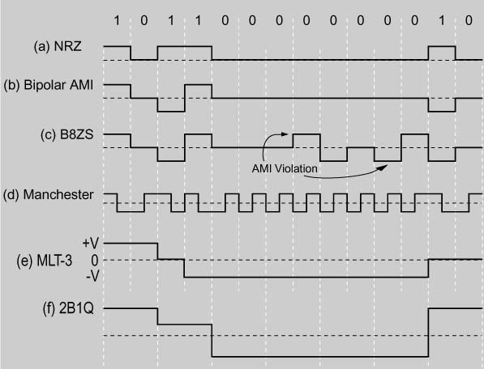
Data Encoding Methods

Slide 18
Non-Return to Zero (NRZ)
NRZ is the simplest representation of digital signals
One bit of data is transmitted per clock cycle
Bit values of 1and 0 are represented by high and low voltage signals, respectively
Two downfalls of NRZ: 1. DC component, and 2. Inability to carry synchronization information along with the data
  If a NRZ signal has a sequence of 1s, the signal cannot pass through electrical components, which conduct only when the signal is changing. The receiver will require an additional synchronization signal to determine how many 1s there are

Slide 19
Bipolar Alternate Mark Inversions (Bipolar AMI)
In Bipolar AMI, marks are analogous to 1s and spaces are analogous to 0s
This means a logical one is represented by a signal and a logical zero is represented by no signal
The Bipolar AMI solves the DC component problem by alternating the polarities of 1s
However, Bipolar AMI signals can lose self-synchronization when transmitting a long string of 0s

Slide 20
Bipolar with 8 Zero Substitution
(B8ZS)
This coding method takes care of the self- synchronization problem by breaking the alternation rule when it comes across a sequence of eight consecutive 0s
This rule puts 1s in place of the fourth and fifth 0s and in places of the seventh and eighth 0s
The first substitute incorrectly has the polarity of the previous 1, and the third substitute incorrectly has the polarity of the second substitute 1
The receiver recognizes an intentional violation and concludes that there is a sequence of eight 0s

Slide 21
Manchester Encoding
Manchester encoding is implemented in Ethernet and Token Ring LAN technologies
A 1 is indicated by a high to low transition in the middle of a pulse, while a 0 is indicated by a low to high transition in the middle of the pulse
Unlike NRZ and Bipolar AMI, Manchester encoding has no DC component and is fully self-synchronizing
Its drawback it that its bandwidth requirement is twice the baud rate
  For 10 Mbps transmission, it operates at 20 MHz frequency

Slide 22
4B/5B Encoding
Every 4-bit pattern is assigned a 5-bit code
Instead of the 4-bits, the 5-bit code is transmitted
The 5-bit code is picked such that there are at least two transitions in every 5-bit code
  Therefore, an encoded stream will never contain more than 3 zeros in a row
  This helps synchronization and leads to higher data transfer rates
Used in Fast Ethernet and FDDI
Gigabit Ethernet uses 8B/10B Encoding, based on the same principle, where an 8-bit pattern is assigned a 10-bit code

Slide 23
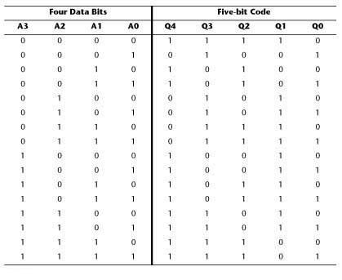
4B/5B Encoding Chart

Slide 24
2 Binary 1 Quaternary
(2B1Q)
2B1Q uses four distinct signaling levels, with data represented in two-bit units
2B1Q represents the distinction between bits per second and baud rate
2B1Q has been implemented in broadband technologies such as ISDN, SDSL and HDSL

Slide 25
Error Detection and Correction
Integrity of information is ensured in two steps:
  Detecting errors when they occur at the receiver during transmission
  Triggering retransmission or performing an error correction in the event that an error is detected

Slide 26
Parity Checking
One of the simplest error-detection schemes
It refers to the use of parity bits to check that data has been transmitted accurately
There two types of parity: odd and even
Parity checking has limitations
  It cannot detect an error when an even number of bits change in the same data unit

Slide 27
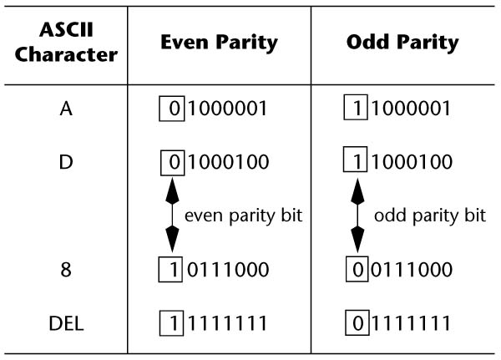
Parity Checking
(with parity bits shown in boxes)

Slide 28
Longitudinal Redundancy Check (LRC)
Operates on a group of bytes
Create a cross-grid matrix pattern to pinpoint a bad bit
Produces a Block Check Character (BCC) to provide extra error-detection capabilities for a block of data
Advantage
  It is simple and improves the odds of detecting errors
  Provides error correction at the receiver, which simply inverts the bad bit
Disadvantage
  It has significant overhead

Slide 29
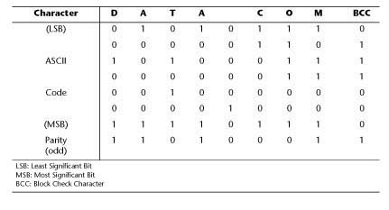
Example of LRC Implementation

Slide 30
Hamming Code
Hamming Code is a error-detection-and-correction scheme for single-bit errors
Generates several parity bits that are interspersed with data in a specific pattern
One data bit affects more than one parity bit, so the bad bit can be detected
Its error correction capability eliminates the need for retransmission
It uses forward-error-correction
  Error corrected by the receiving device

Slide 31
Cyclic Redundancy Check (CRC)
One of the most widely used, reliable, and efficient error-detection schemes
Used in synchronous transmission where blocks of data can be several thousand bytes and where single bit errors occur less frequently as compared with multiple or burst errors
CRC uses a unique mathematical algorithm, which is known to both the transmitter and the receiver
The bit pattern (16 or 32 bits) that is used to verify the data is called a Frame Check Sequence (FCS)

Slide 32
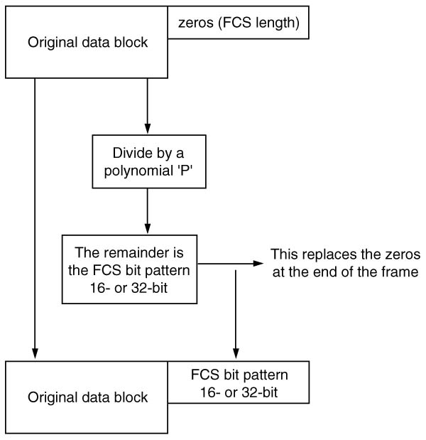
CRC Process Flowchart

Slide 33
Data Link Protocols
Data link layer deals with how data is logically packaged to cross from one user to another
Data link protocols are divided into two broad categories:
  Bit-oriented
    Encode control information in single bits
    HDLC is the most common bit-oriented protocol
  Byte-oriented or Character-oriented
    Encode control information in bytes
    BISYNC is the most common byte-oriented protocol

Slide 34
HDLC Bit-oriented Protocol
HDLC
  Allows every device to both send and receive information without being controlled by any other device, so that all devices have equal right to use the communication facility
  Ethernet, Token Ring and FDDI are all based on the HDLC frame structure

Slide 35
Opening Flag | Station Address | Control Info. | Data Field | CRC | Closing Flag
Opening Flag | Station Address | Control Info. | Data Field |  | Closing Flag
An HDLC Frame Format
An Opening Flag is a sequence of 8-bits, which marks the beginning of a packet, followed by a 16- or 32-bit Station Address. One to two bytes of control information describe the type of HDLC frame, routing parameters, and other packet identifiers. The variable Data Field or Raw Data is now inserted, followed by a 16- or 32-bit FCS (CRC) and a 8-bit Closing Flag, which marks the end of the HDLC frame. The HDLC frames are created by equipment that transmits the packet across the network.

Slide 36
LAN Access Methods
A LAN Access method describes how the devices access the network and share the transmission facilities
By definition, a shared-media LAN has only one path to handle high-speed data. However, the total capacity of the path exceeds the transmission speed of any single station, so stations are usually unaware that they are sharing the medium.
Popular LAN access methods are classified as non-contention or contention

Slide 37
Polling and Selecting
The Polling and Selecting access method is not very common because it requires the use of a central controller to execute and monitor the process
Polling:
Polling refers to the process of a host computer asking an intelligent terminal if it has any data to send to the host computer. This task is typically accomplished by a front-end processor (FEP), which handles all the routine communications procedures for the host computer
Selecting:
Selecting occurs when a host computer or a FEP sends data to a terminal after the terminal indicates that it is ready to accept data

Slide 38
Token Passing
Noncontention-based deterministic system
A token circulates on the circuit from station to station
The protocol controls which station can send messages by passing a token (3-bit frame) around the “ring”
A transmitting station replaces the token with a message (a data frame with a modified token header)
The message is passed from station to station until it reaches its destination station
The receiving station makes a copy of the message and marks the token (header) to indicate it got the message
The message continues around the ring until it reaches the sending station
The sending station sees that the message was received and replaces it with a new token

Slide 39
Carrier Sense Multiple Access
(CSMA)
Multiple Access
  Any of the network devices can transmit data onto the network at will; there is no central controller
  A broadcast network where all stations see all frames, regardless of whether they represent an intended destination
  Each station must examine received frames to determine if the station is a destination. If so, the frame is passed to a higher protocol layer for appropriate processing
Carrier Sense
  Before sending data, stations listen to the network to see if it is already in use. If in use, the station wishing to transmit waits, otherwise it transmits

Slide 40
CSMA/Collision Detection (CSMA/CD)
Collision occurs when two stations listen for network traffic, hear none and transmit simultaneously damaging both transmissions
Collision Detection enables stations to detect collisions, so they know when they must retransmit
Used by Ethernet LANs

Slide 41
CSMA/Collision Avoidance (CSMA/CA)
Sender send a request-to-send (RTS) frame to receiver and indicates the time needed to complete data transmission
Receiver send clear-to-send (CTS) frame, indicates time to complete data transmission and reserves channel for the sender
Sender transmits the data and receiver responds with an ACK frame, ensuring reliable transmission
RTS and CTS frames let other stations know of the data transmission so that collision is avoided
Used by 802.11 wireless LANs

Slide 42
LAN TECHNOLOGIES
The ability to link a wide range of computers using a vendor-neutral network technology is an essential feature for today’s LANs
Most LANs must support a wide variety of computers purchased from different vendors, which requires a high degree of network interoperability
Baseband LAN technologies include Token Ring, Ethernet, and Fiber Distributed Data Interface (FDDI)

Slide 43
Token Ring
IEEE 802.4 (Bus) or 802.5 (Ring) Standard for the Token Ring (Physical and Data Link Layers)
  Protocol: Token Passing
  Data Link Control Protocol: HDLC
  Error Detection and Correction Method: CRC
  Data Encoding Format: Differential Manchester
  A MAU (Multistation Access Unit) transfers the token from port to port
  Characteristics
    Predictable response time even under heavy load
    More robust compared with Ethernet, but also more expensive
    Not very popular today due to its limited speed (16 Mbps)

Slide 44
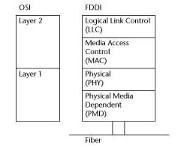
FDDI

Slide 45
Ethernet
Formal specifications for Ethernet were published in 1980 by a multi-vendor consortium that created the DEC-Intel-Xerox (DIX) standard
It marked a turning point in the evolution of experimental Ethernet into an open, production-quality system
Ethernet and 802.3 have many common features
  Protocol: CSMA/CD
  Data Link Control Protocol: HDLC
  Error Detection and Correction Method: CRC
  Data Encoding Format: Differential Manchester

Slide 46

Ethernet Frame Format

Slide 47
Ethernet Frame
Preamble
  The alternating pattern of 1s and 0s tells receiving stations that a frame is coming. An additional byte serves to synchronize the frame-reception portions of all stations on the LAN.
Destination and Source Addresses
  Each address comprises of 6 bytes
Length
  Indicates the number of bytes of data
Data
  Payload or actual data, which can vary from 46 to 1500 bytes
Frame Check Sequence (FCS)
  Contains a four-byte CRC value
Ethernet LANs are 10BaseT, 100BaseT, and 1000BaseT

Slide 48
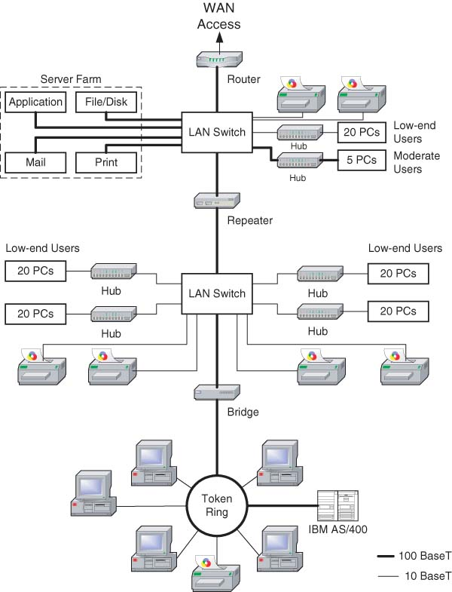
Typical 10BaseT and 100BaseT LAN Configuration

Slide 49
LAN Configurations
Client/Server
  Most popular networking strategy
  Servers provide special services to users
  Clients make requests to use server resources
  NIC enables a full-time, dedicated connection to the network
  NOS controls the entire network
Peer-to-Peer
  Appropriate for a small group of users that may want to share some of their individual resources such as disk-drives, scanners and printers
  NOS is installed on every machine that is part of the network

Slide 50
Internetworking
Internetworking is a comprehensive term for all the concepts, technologies, and generic devices that allow people and their computers to communicate across different kinds of networks
Some Internetworking Devices are:
    Repeaters
    Bridges
    Switches
    Routers
    Gateways

Slide 51
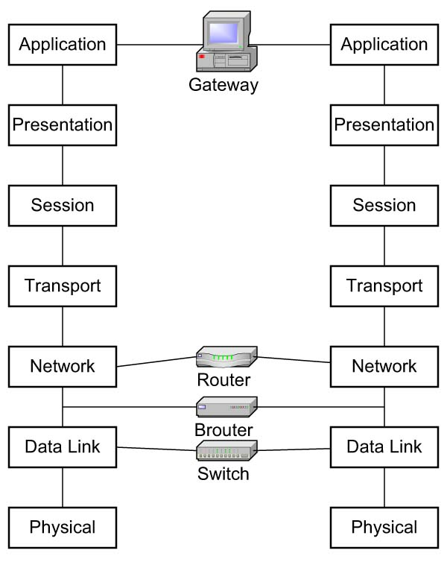
Internetworking at various layers of the OSI model

Slide 52
Repeaters
A Repeater is the simplest and the least expensive internetworking device. It copies every messages it hears on LAN #1 to LAN #2, sometimes unnecessarily.
  Operates at Layer 1 of the OSI model
  It receives a signal, amplifies it, and then retransmits it along the next leg of the medium
  If the two LANs connected with a repeater do not have a traffic problem, there is no need for a more complex approach. However, most LANs that are long enough to have reached their distance limitation probably have many users and there could be advantages to using more sophisticated devices than repeaters.

Slide 53
Bridges
A bridge is a device that operates at the data link layer of the OSI model
It selectively forwards frames based on an examination of the MAC addresses in the frames
It filters out the messages meant for the other stations
A Bridge is used to interconnect networks using dissimilar protocols

Slide 54
Characteristics of a Bridge
A bridge connects one LAN to another LAN that uses the same protocol (for example, Ethernet or Token Ring)
A transparent bridge automatically initializes itself and configures its own routing information after it has been enabled
Since bridges buffer frames, it is possible to interconnect different segments which use different MAC protocols
Subdividing the LAN into smaller segments, increases overall reliability and the network becomes easier to maintain
Non-routable protocols like NETBEUI must be bridged
Bridges help to localize network traffic by only forwarding data onto other segments as required (unlike repeaters)
In complex networks, data may be sent over redundant paths, and the shortest path is not always taken

Slide 55
Switch
A switch is a device that is used to connect and distribute communications between a trunk line or backbone and individual nodes
It operates at Layer 2 of the OSI model
When you install a switch you are “collapsing the backbone” of the network
A switch improves network performance
Servers and Hubs may be connected to ports on the Switch
Characteristics and Applications
  Delivers more bandwidth
  Simplifies network administration

Slide 56
Router
A “router” is a device that operates at the network layer of the OSI model
It supports multiple protocols (such as TCP/IP, DecNet, SNA, IPX), and can be used to link LANs together locally or remotely as part of a WAN
It controls network traffic and security in the process of delivering a message across one or more networks via the most appropriate path

Slide 57
Characteristics of Routers
Expensive piece of hardware
Comes with its own administrative burden
Can slow down the network
Have a lower packet-filtering-and-forwarding rate as compared to switches
Protocol-dependent and cannot handle protocols that are not routable
The move now is towards implementing “switching routers”

Slide 58
Gateways
A Gateway is an inter-networking device that connects two or more computer networks that use different communications architectures
Operates at Layer 7 of the OSI Model
Compares and converts the communication protocols of one networking system with the communication protocols of another (usually proprietary) system
  Example: Between Ethernet and SNA, where SNA (Systems Network Architecture) is the IBM Mainframe Protocol

Slide 59
Channel Service Unit (CSU)
Data Service Unit (DSU)
Come in either stand-alone units or combination CSU/DSUs
Their purpose is to encapsulate information into proper framing and ensure proper timing before connecting to the WAN
At least one of these devices is required for any digital line termination
CSU is used to connect a switched digital line such as a T-1 to a DCE device
  Protects the line from electrical damage
  Provides a way to test the circuit through loopback
DSU is used to access dedicated lines

Slide 60
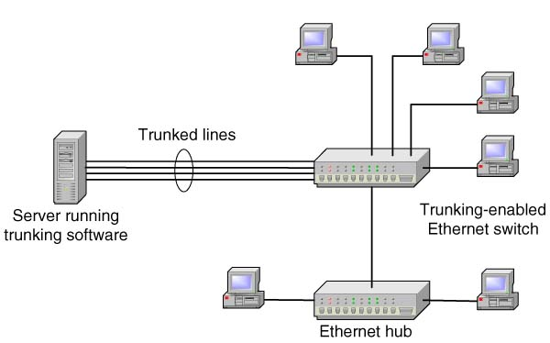
Trunking
Trunking lets companies increase the bandwidth from server to switch

